Slide 1
Apache Spark

Slide 2
What is Spark?
Why Spark?
Spark Vs Hadoop

Slide 3
What is Spark ?
Open source fast and general engine for large data processing.
Developed in 2009 in UC Berkeley’s AMP Lab, and open sourced in 2010 as an Apache project.
Written in Scala.
In memory processing framework.
Provides high-level APIs in Java, Scala, Python and R.
Notes:
Note:
Spark 1.x is written in Scala 2.10 and Spark 2.x is written in Scala 2.11.

Slide 4
Why Spark ?
Unified framework to manage big data requirements.
Provides high level operators such as filter, map, etc..
100x faster in memory, 10x faster on disk.
Spark Shell
- Interactive - for data exploration and testing.
- Scala or Python
Spark Applications
- For large scale and data processing.
- Scala, Python or Java
Notes:
Notes:
Unified framework:
Apache Spark provides one integrated API to perform different tasks that would have previously required separate processing engines such as batch analytics, stream processing and statistical modelling.

Slide 5


Spark Vs Hadoop
How Hadoop stores data?
Block1
Block1
Block3
Block1
A very Large Data File
Block 2
Block 2
Block 2
Block3
Block 3
Block 2
Block1
Block3

Slide 6

Spark Vs Hadoop
What change Spark has brought in?
Block1
Block1
Block3
Block1
A very Large Data File
Block 2
Block 2
Block 2
Block3
Block 3
Block 2
Block1
Block3

Slide 7
Spark Vs Hadoop
 | Spark | Hadoop
Introduction | Faster and general purpose data processing engine. Handles batch as well real time processing. | Processes structured and unstructured data that are stored in HDFS. Handles only batch processing.

Slide 8
Spark Vs Hadoop
 | Spark | Hadoop
Speed | Run programs up to 100x faster than Hadoop MapReduce in memory, or 10x faster on disk. Reducing the number of read/write cycle to disk and storing intermediate data in-memory. | Reads and writes from disk and that slows down the processing speed.

Slide 9
Spark Vs Hadoop
 | Spark | Hadoop
Difficulty | Provides high level operators. E.g. filter, map | No high level operators. Need to hand code each and every operation.

Slide 10

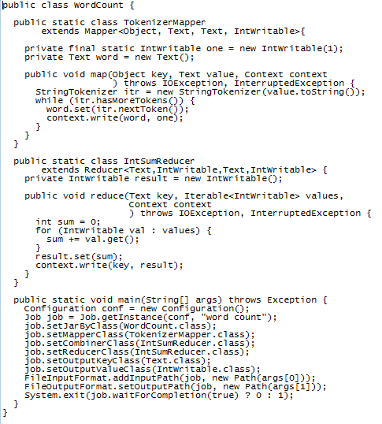

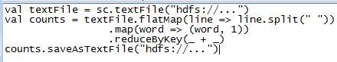
Spark Vs Hadoop
Big Code
Tiny Code

Slide 11
Questions
Notes:
Application Delivery Fundamentals (ADF) 2.0: Testing
Module 02: Introduction to Software Development Life Cycle (SDLC)

Slide 12
Thank You

